Slide 1
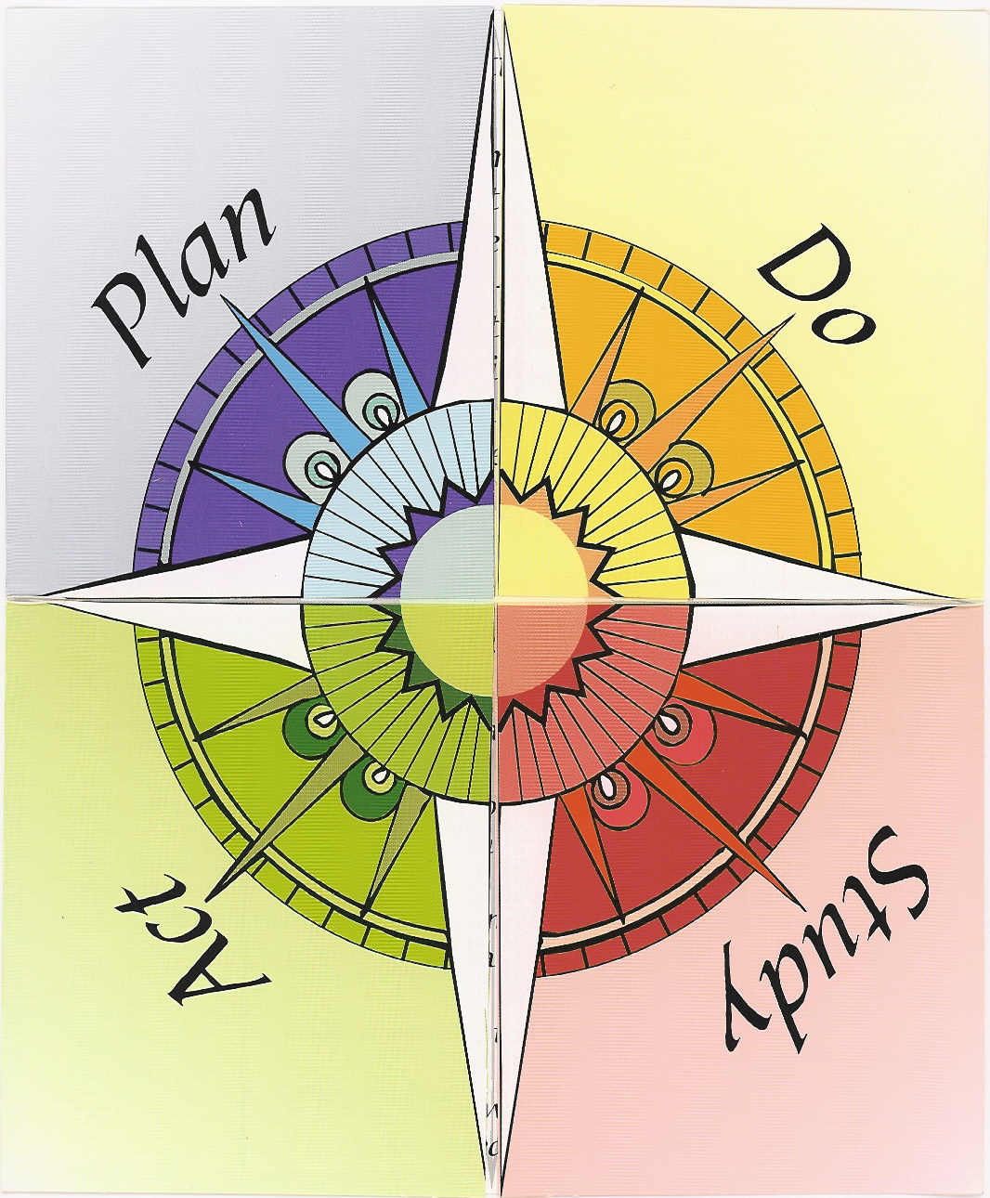
FCIM and School Improvement 2013-14
Notes:
[Recommend having this as a poster up in the training room and refer to when presenting.]
The Plan-Do-Check-Act process was developed by Dr. Walter Shewhart and later incorporated into the work of E. W. Deming. Dr. Deming credits Shewhart with teaching him that there are two ways of doing things: the old way and the new way. It requires planning, implementation, assessment of success and revision. It is often referred to as the PDCA cycle.

Slide 3
8-Step Overview: Components
Identify Instructional (Learning) Goals (Plan)
Develop Timelines, Identify Strategies (Plan)
Deliver Instructional Focus Lessons (Do)
Conduct Assessments (Study)
Account for Skill Maintenance (Study)
Monitor Effectiveness (Study)
Deliver Tutorials and Enrichment (Act)
Adjust Strategies (Act)
Notes:
Here are the components listed in the Plan-Do-Check-Act cycle in a format easier to read. We will be covering each of these components in our training today and tomorrow.
Data-driven
Focused instruction
Identifies instructional needs
Identifies struggling students
Provides re-teaching for mastery
Monitors student learning
The strengths of the FCIM model are:
The use of data in making decisions and pedagogical choices rather than subjective opinions, hunches, traditional ways of teaching and testing students, or relying on the status quo to raise student achievement
Because objective decisions are reached on data, teacher subjectivity is eliminated
With careful and thorough data analysis, specific subjects and grade levels and student subgroups are identified
Constant monitoring of student progress along with deeper mining of test data result in the ability to identify individual students who need more help in targeted benchmarks, clusters and strands. What to re-teach and who needs it are made apparent from the data analysis and tracking of student learning.

Slide 5
Problem-Solving Focus
Based on the targets set for your school in each required Area, engage in a problem-solving process using the following questions. Goals shall specifically address any subgroup not meeting its AMO targets for 2012-2013. The special needs of subgroups not addressed in the AMO report (e.g., migrant, homeless, neglected and delinquent) shall also be considered during this process. Operational data such as climate surveys and classroom walkthroughs may also be used as available and relevant.
Step 1: Identify goal(s) to help you achieve your targets. (Select one or more Areas each goal addresses.)
Step 2: Brainstorm which resources are available to support the goal and barriers that could prevent achieving the goal; prioritize barriers.

Slide 6
Step 3: Choose some barriers to address, based on alterable elements of curriculum, instruction, environment, and organizational systems (e.g., those which have the most impact on the goal if removed or are immediately actionable).
Step 4: Brainstorm and prioritize strategies that could be used to eliminate or reduce each targeted barrier.
Step 5: Identify action steps (including who, what, where, when) that will need to be taken to implement the identified strategies.

Slide 7
Step 6: Determine how strategies will be monitored for fidelity of implementation (including who, what, where, when).
Step 7: Determine how strategies will be monitored for effectiveness (including who, what, where, when).
Step 8: Determine how progress towards each goal will be monitored (including who, what, where, when).

